Slide 1


POWER point PRESENTATION ON DEFORESTATION AND DESERTIFICATION
NAME : S.VENNELA
SUBJECT : ENVIRONMENTAL SCIENCE

Slide 2
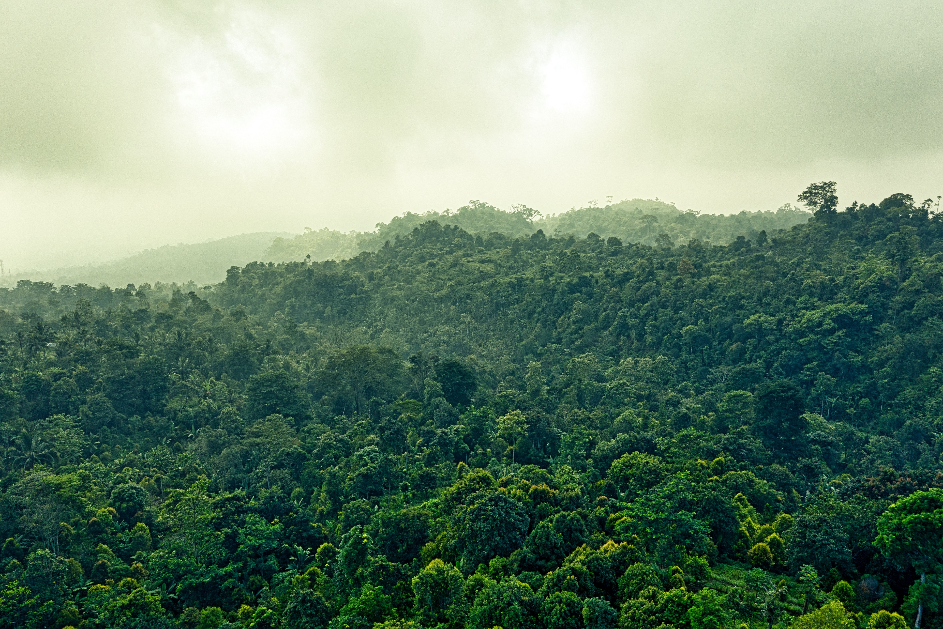
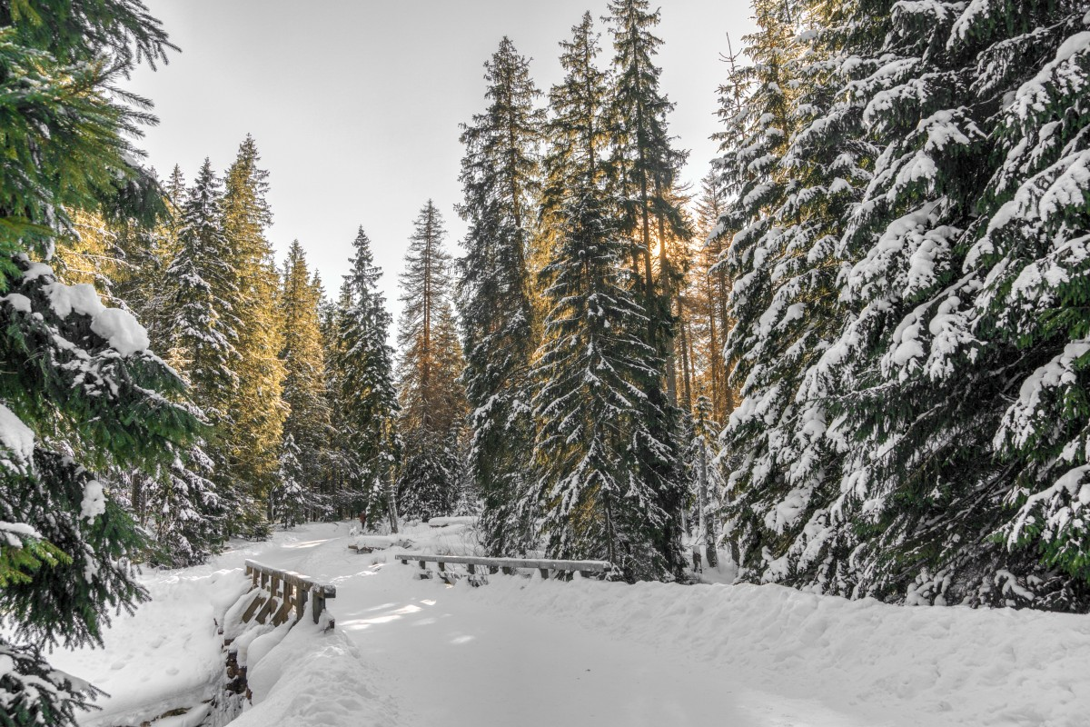

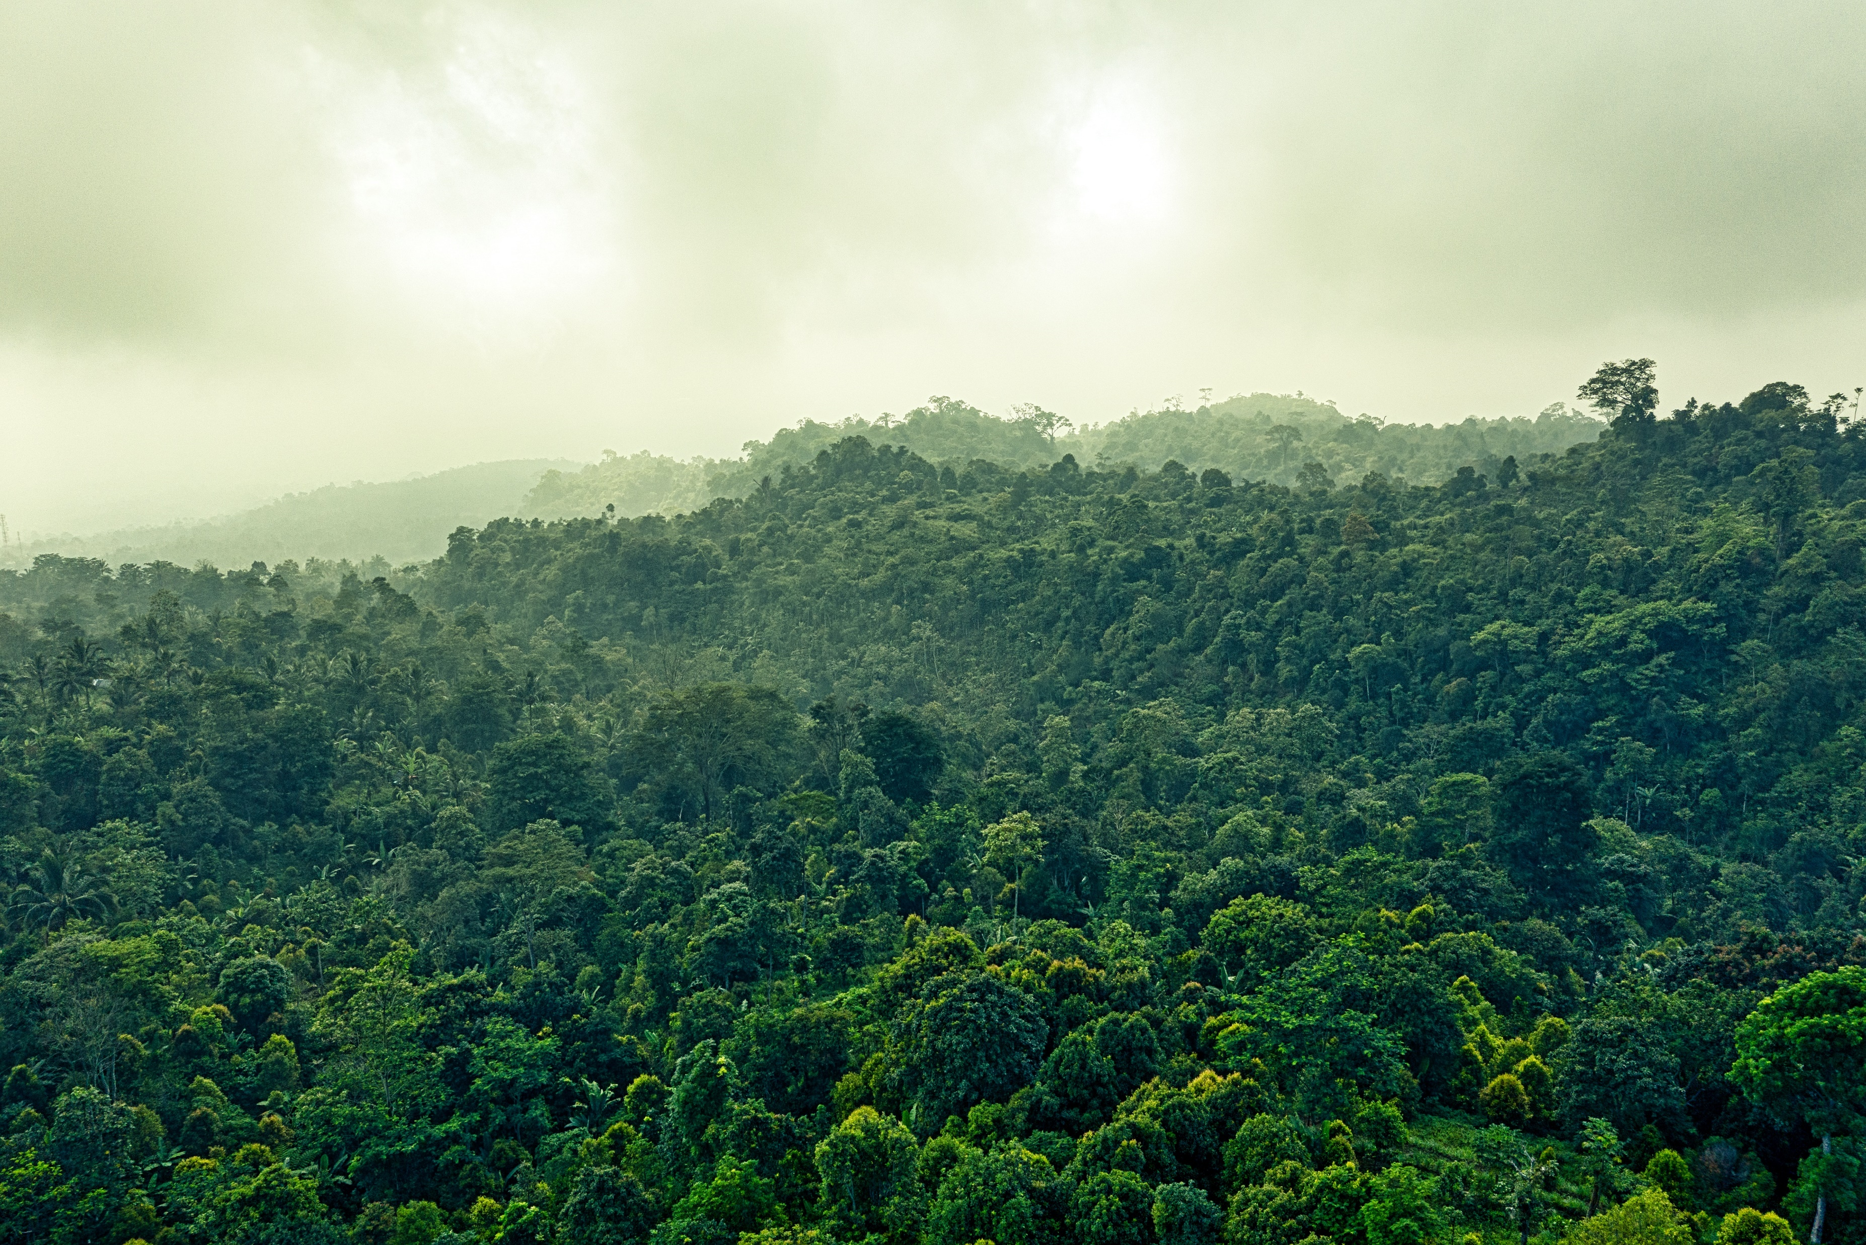
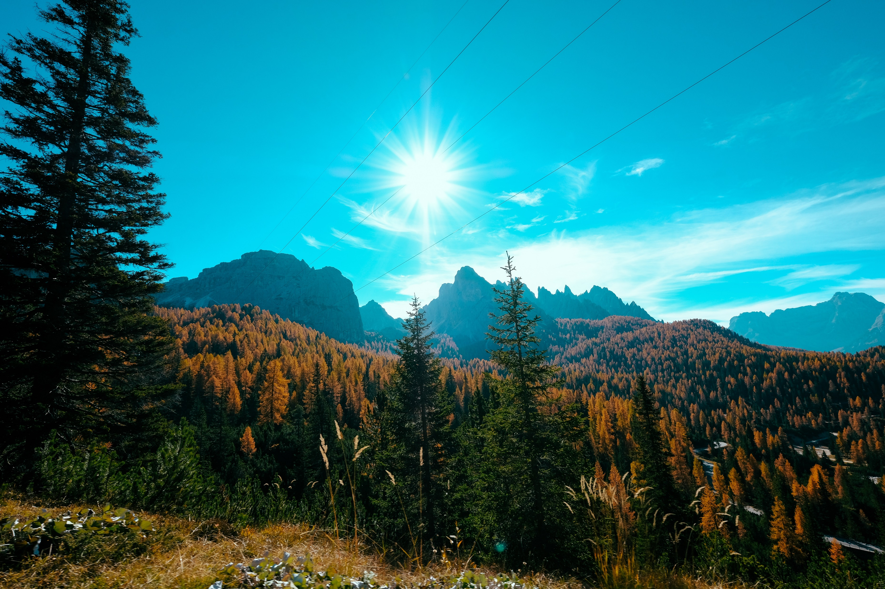
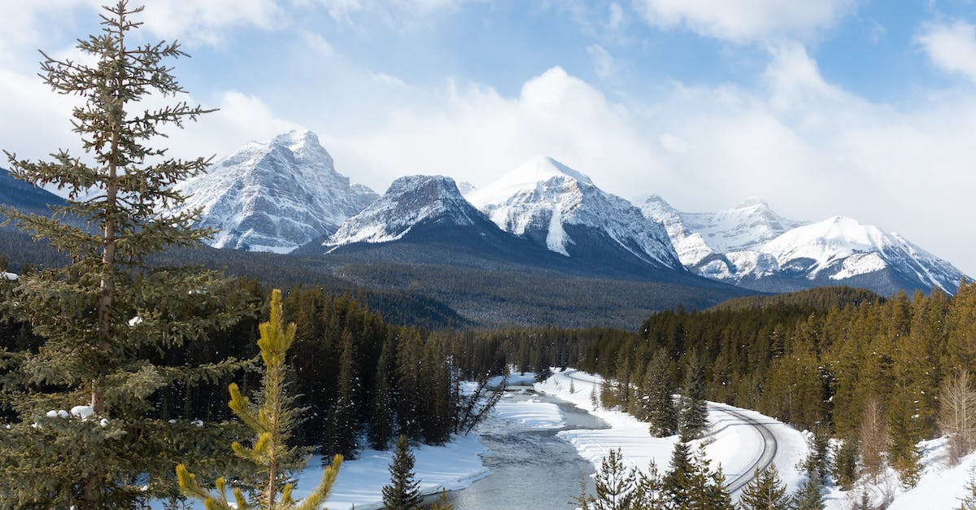
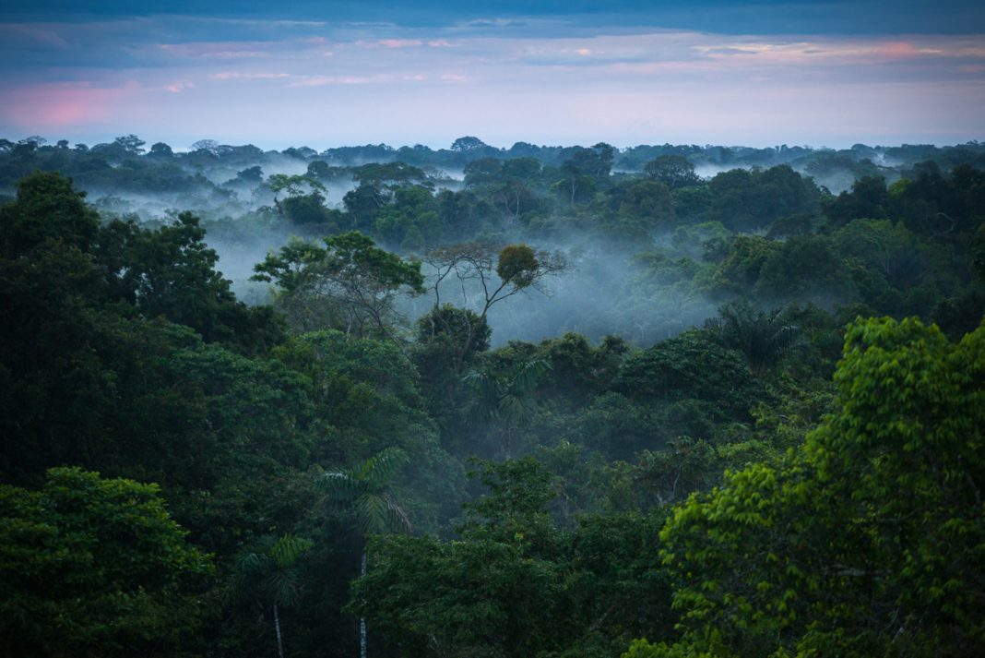

This Photo by Unknown Author is licensed under CC BY-NC-ND
This Photo by Unknown Author is licensed under CC BY-ND

Slide 3
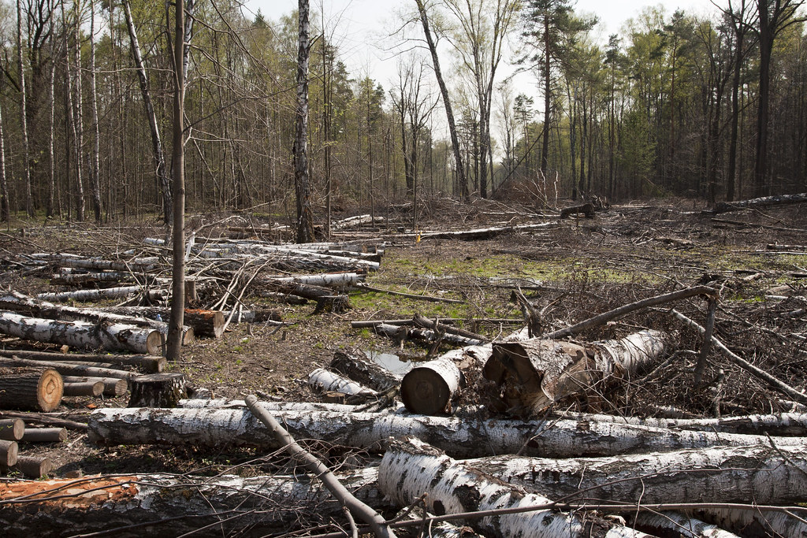
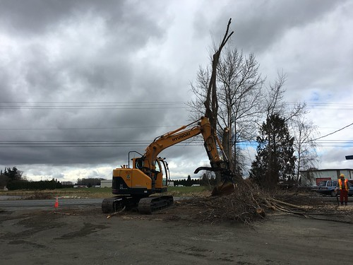
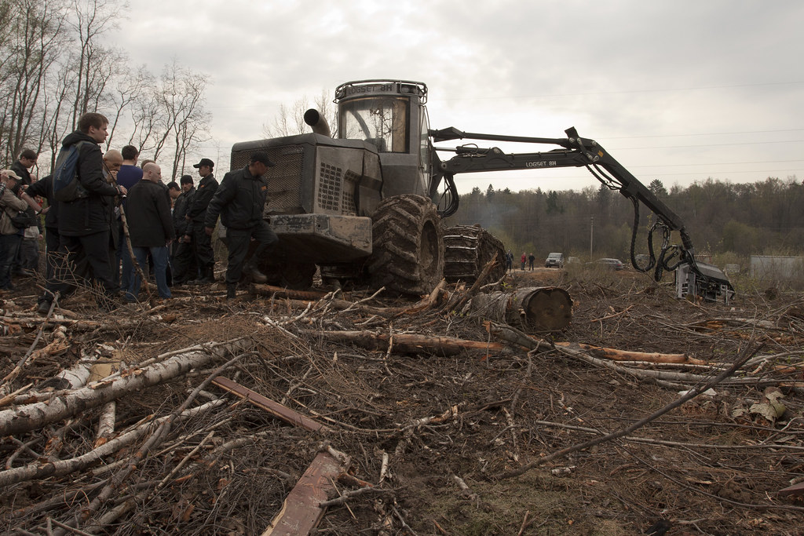
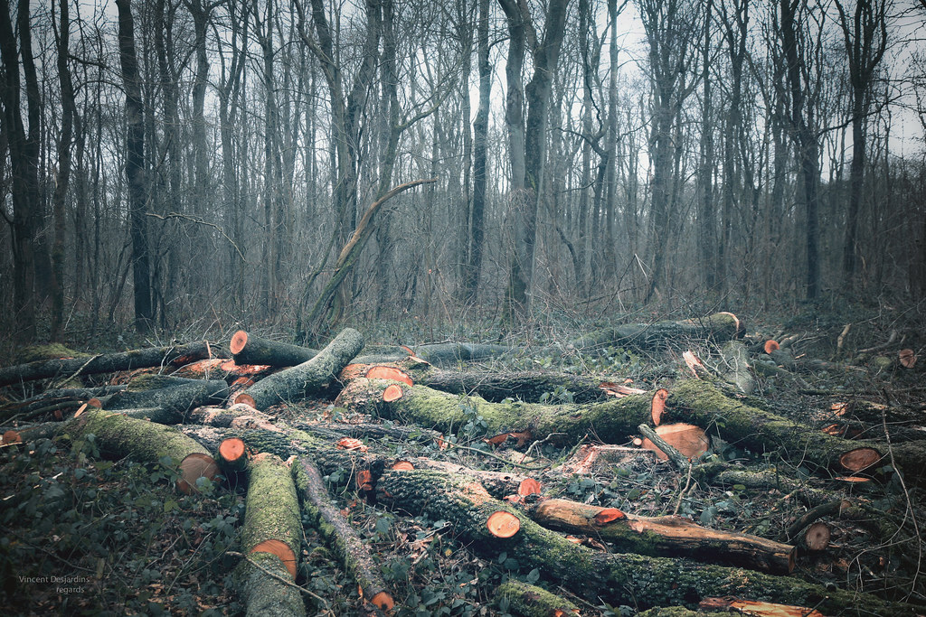
This Photo by Unknown Author is licensed under CC BY-SA
This Photo by Unknown Author is licensed under CC BY
This Photo by Unknown Author is licensed under CC BY-SA

Slide 4

DEFORESTATION
Through out history and into modern times ,forests have been razed to make space for agriculture and animal grazing etc,.
Deforestation is the action of clearing a wide area of trees

Slide 5

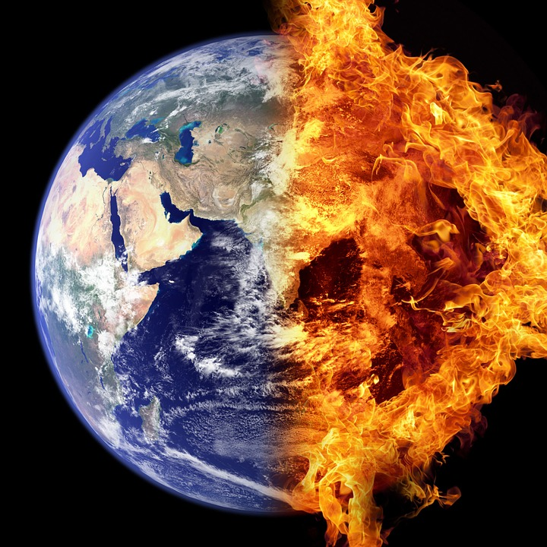

TOPICS :
CAUSES
EFFECTS
MEASURES

Slide 6
CAUSES OF DEFORESTATION
COLONIAL ERA : Britishers needed timber supply to build their ships in Britain .They needed timber to build railway sleepers and railway lines.They cleared out forests to make way for tea plantations in INDIA.
Reasons such as plantations,increasing populations ,Unproductive forests,commercial crops,and railways led to deforestation mostly in ancient times

Slide 7
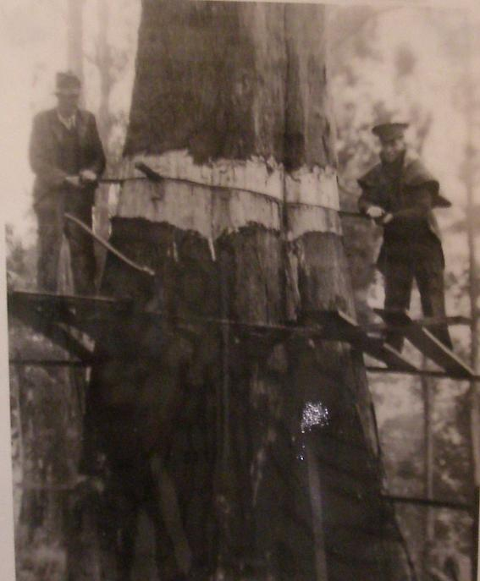
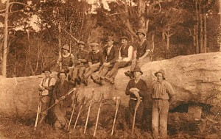
DEFORESTATION IN COLONIAL ERA
This Photo by Unknown Author is licensed under CC BY-NC-ND

Slide 8
CAUSES OF DEFORESTATION
MODERN ERA : Shifting Cultivation ,Development Projects ,Biofuels ,Raw material Requirement ,Land Desertification ,Mining ,Over population ,Urbanization ,Live stock Ranching ,Forest fires ,Paper ,Indiscriminate dam construction ,Agriculture , and the list goes on…….

Slide 9
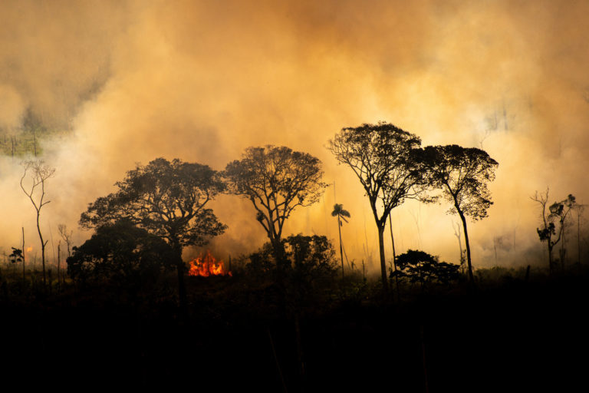
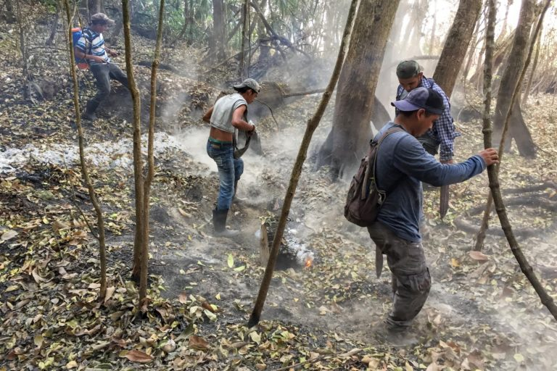
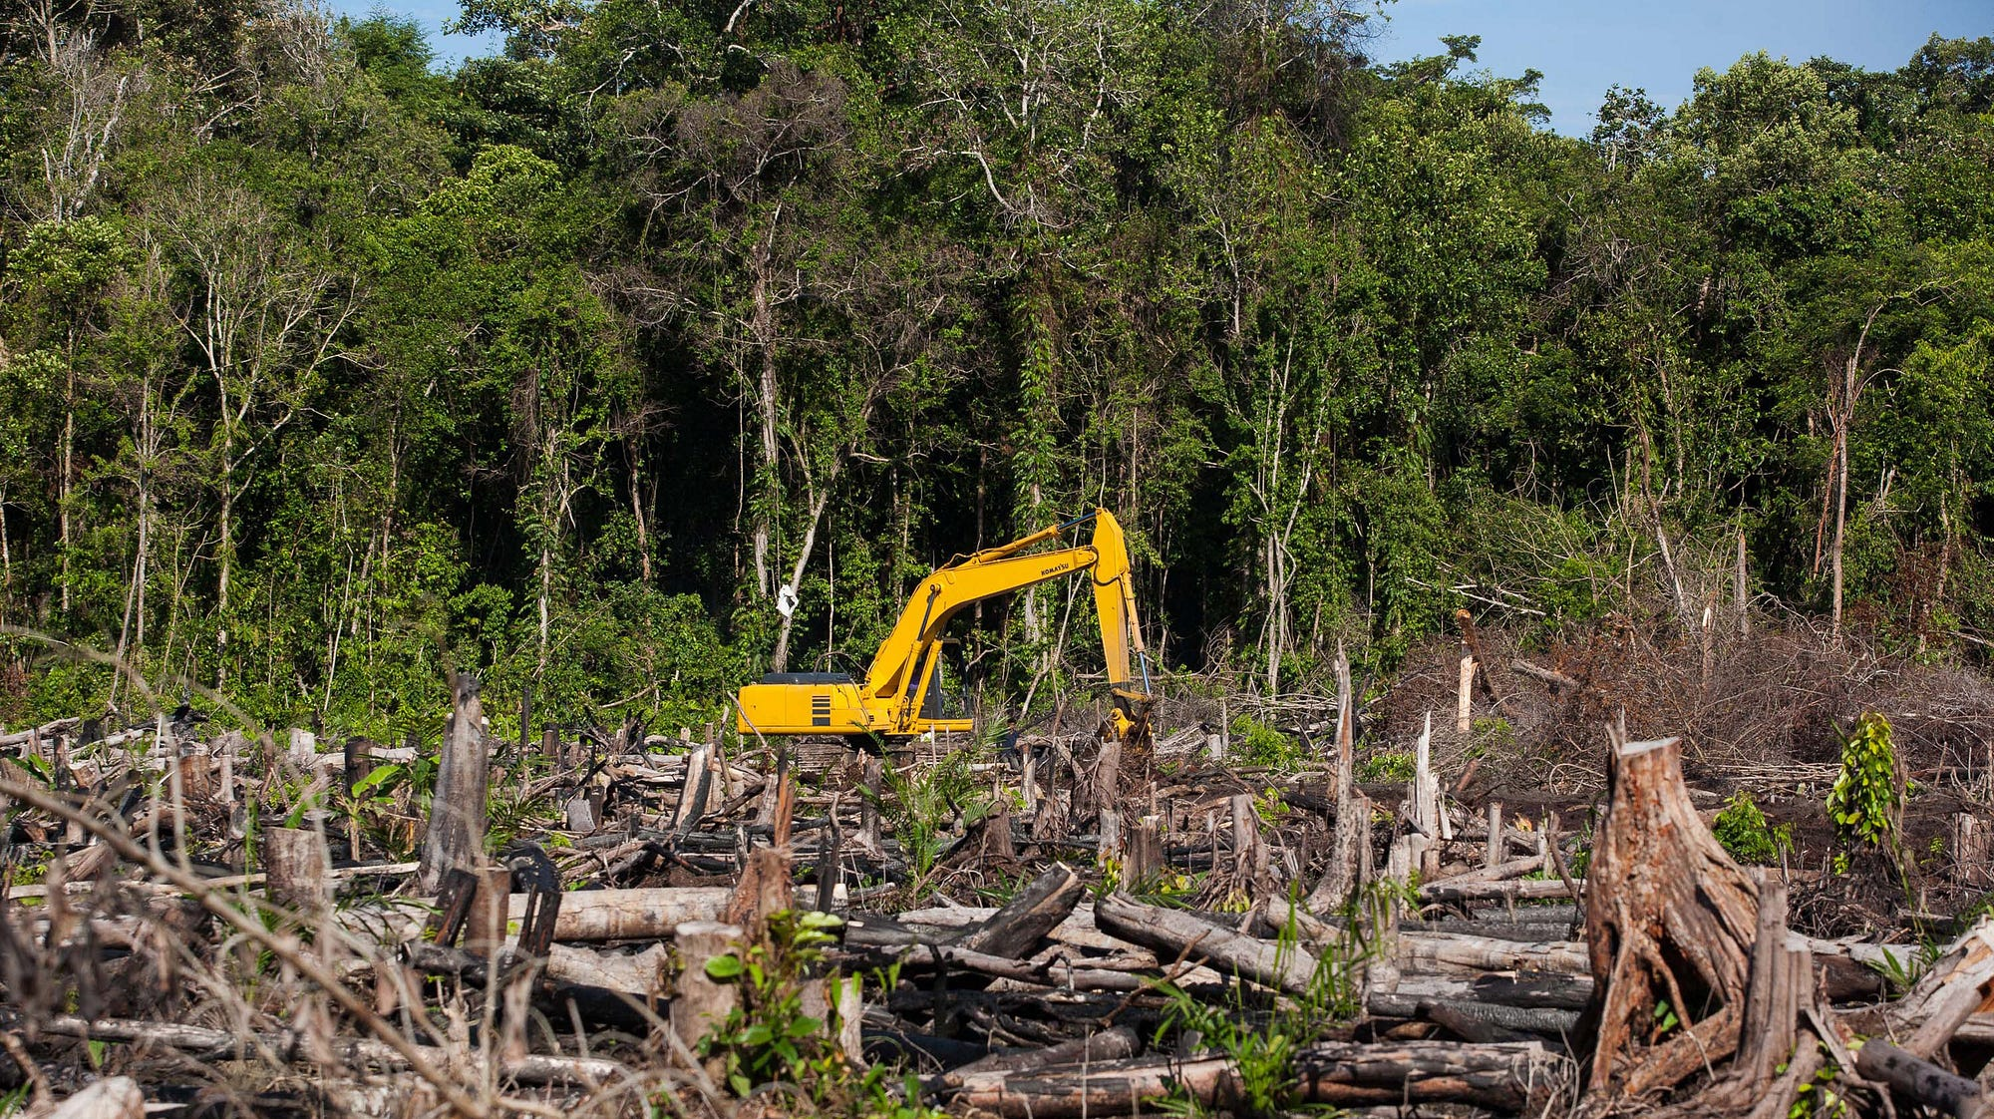
DEFORESTATION IN MODERN ERA
This Photo by Unknown Author is licensed under CC BY-ND

Slide 10
EFFECTS OF DEFORESTATION
The loss of trees and other vegetation can cause Global Warming , climate change ,desertification ,soil erosion ,fewer crops ,Droughts ,flooding ,increased green house gases in the atmosphere , loss of Bio diversity ,damage to natural habitats ,and a host of problems for indigenous people.

Slide 11

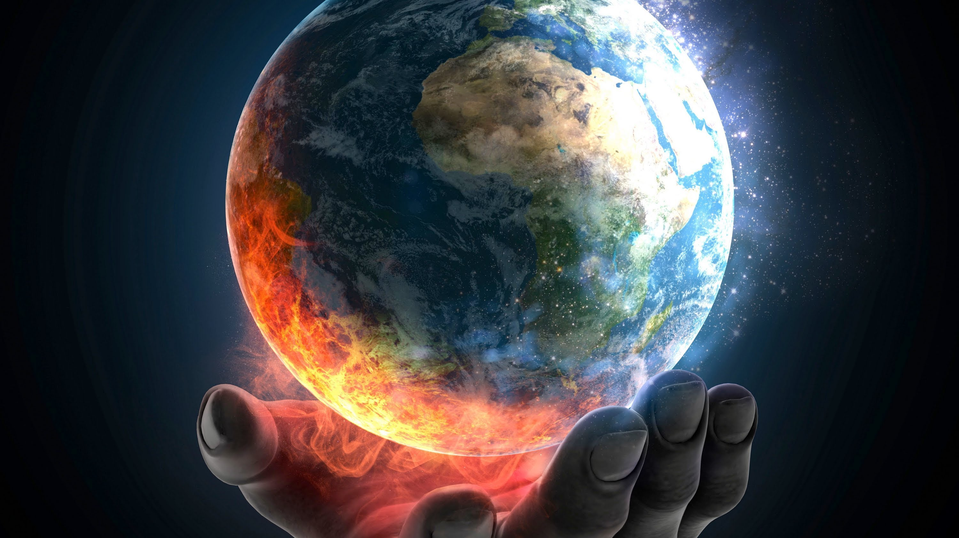
Global Warming
This Photo by Unknown Author is licensed under CC BY

Slide 12
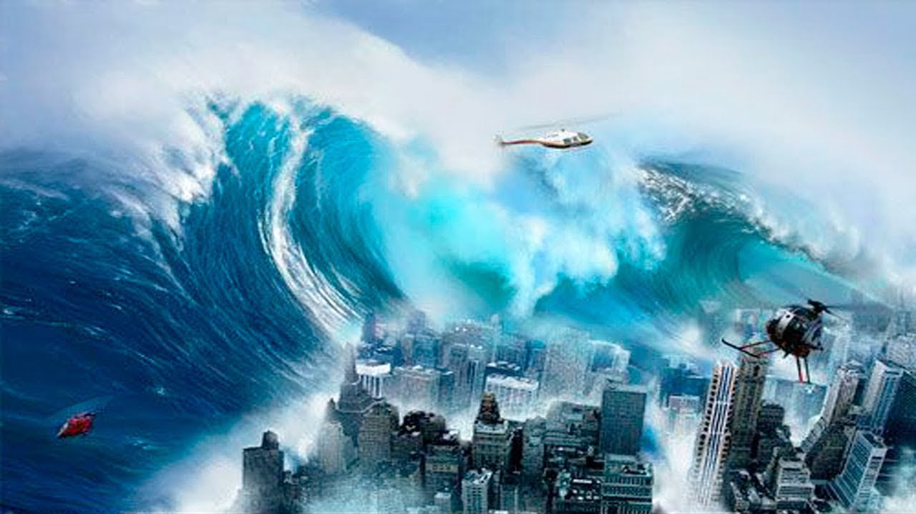
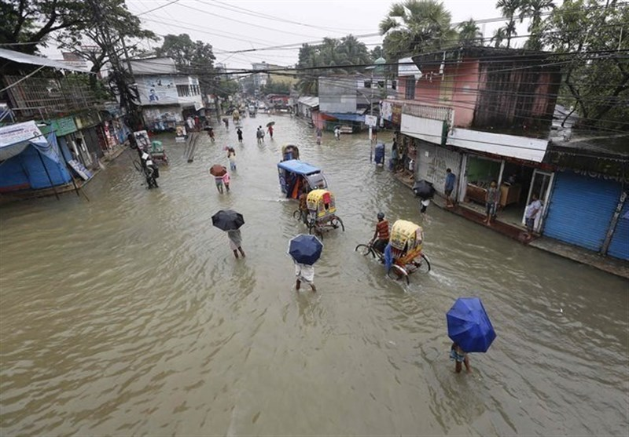
Tsunami
Floods

Slide 13
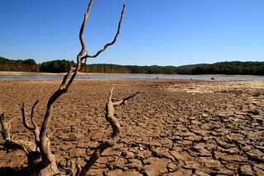
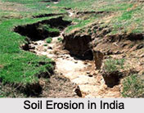
Drought
Soil Erosion

Slide 14
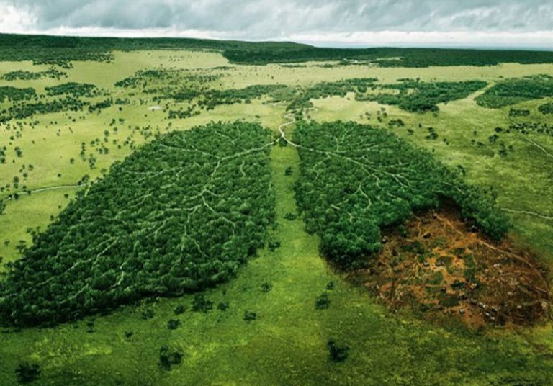
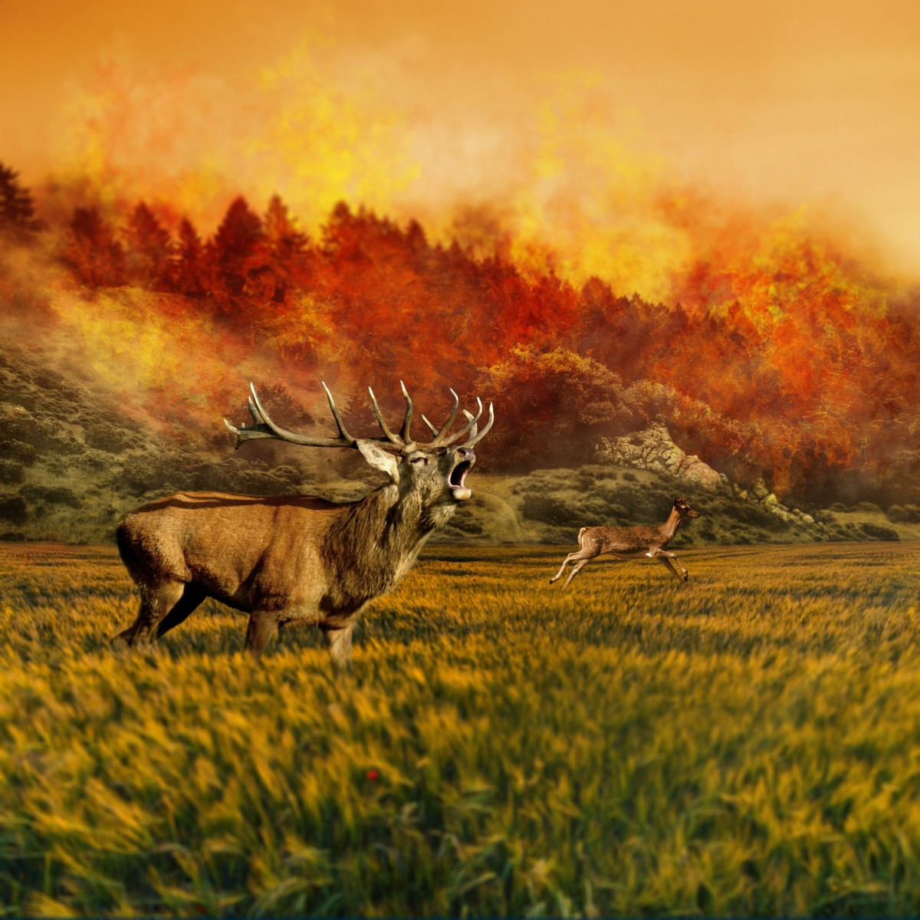
Loss in Bio Diversity

Slide 15
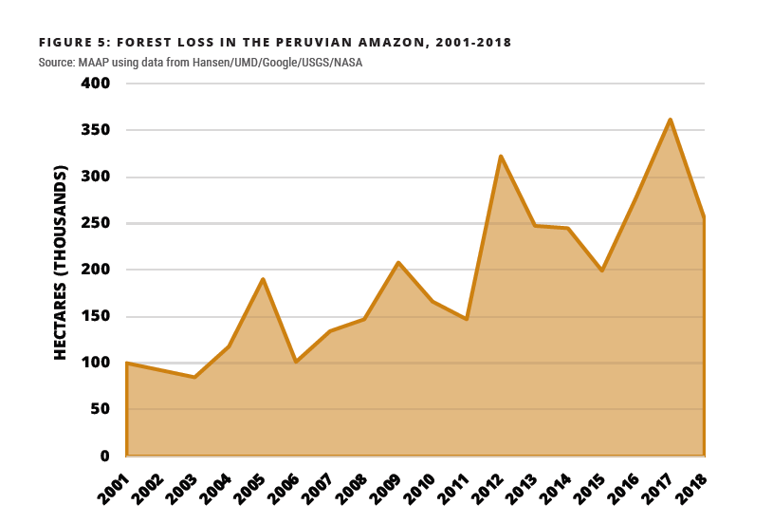
Alarming Rates of Increase in Deforeststion

Slide 16
desertification
The process by which fertile land becomes desert , typically as a result of drought , deforestation , or inappropriate agriculture.
“Nearly one fifth of the world’s land is threatened with Desertification”

Slide 17


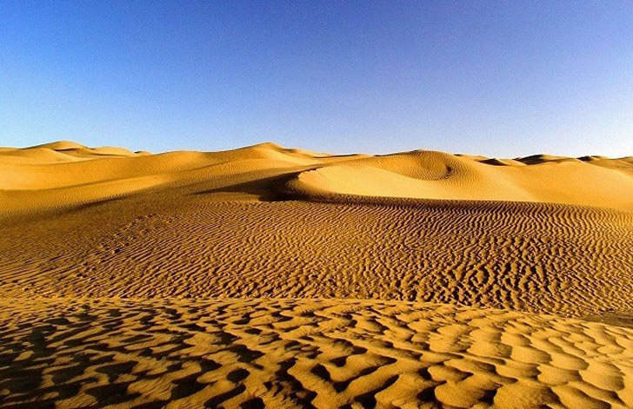
Desertification
This Photo by Unknown Author is licensed under CC BY

Slide 18
CAUSES OF Desertification
Over Grazing ,Deforestation ,Farming Practices ,Urbanization and Other types of and Development , Climate Change ,Stripping of Land resources , Natural Disasters.

Slide 19
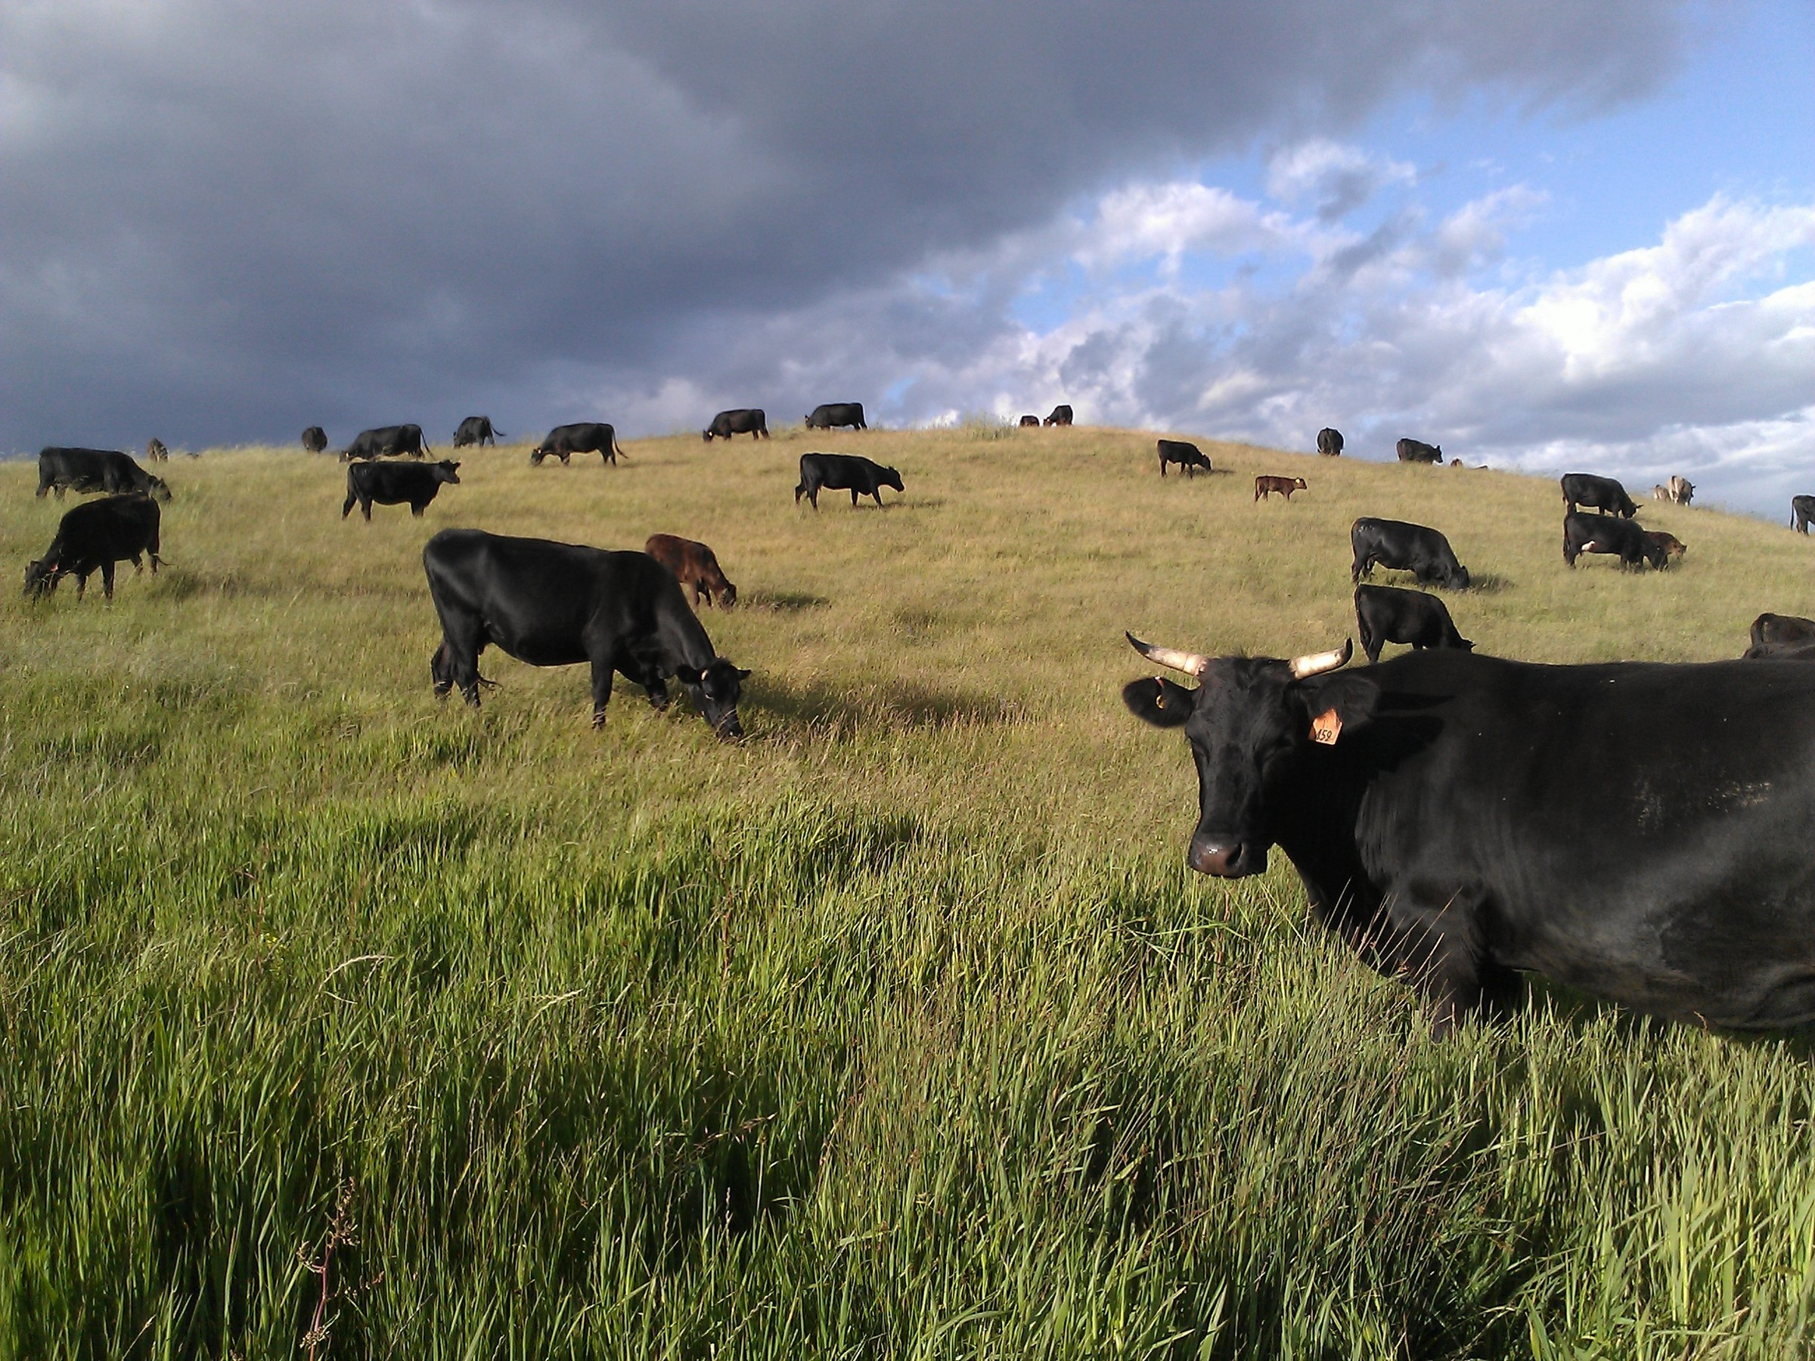
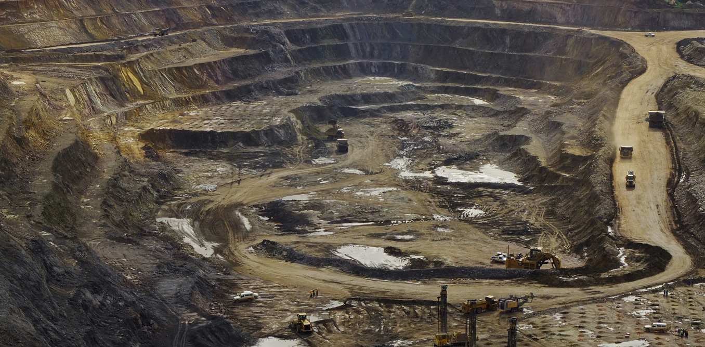
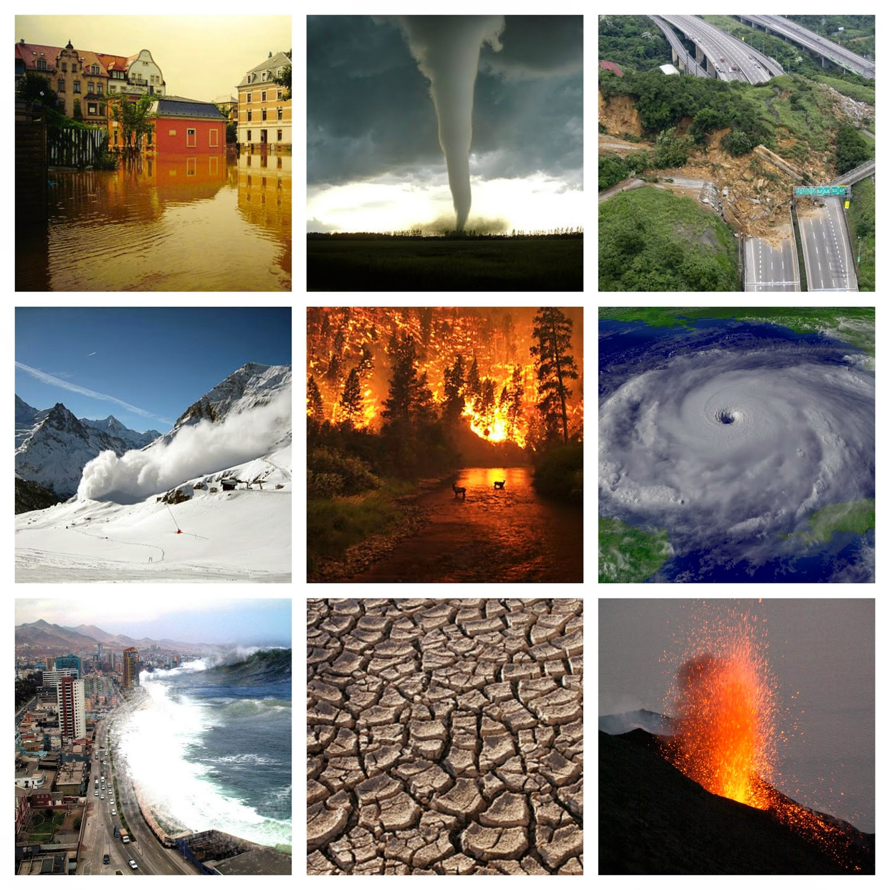
OVER GRAZING
STRIPPING OF LAND RESOURCES
NATURAL DISASTERS
This Photo by Unknown Author is licensed under CC BY-NC-ND
This Photo by Unknown Author is licensed under CC BY-SA-NC

Slide 20
EFFECTS OF DESERTIFICATION
Higher threats of Malnutrition from reduced food and water supplies ,Destruction of vegetation ,Increase in soil Erosion ,Soil Infertility ,Increased susceptibility to natural disasters ,Land Degradation ,Water Pollution ,Extinction of Species ,and loss of Bio Diversity,Increased risk of Zoonotic Diseases,such as Covid -19…..

Slide 21
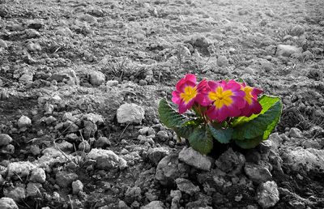

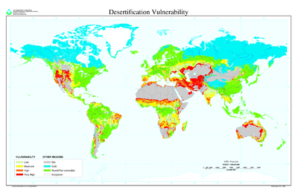
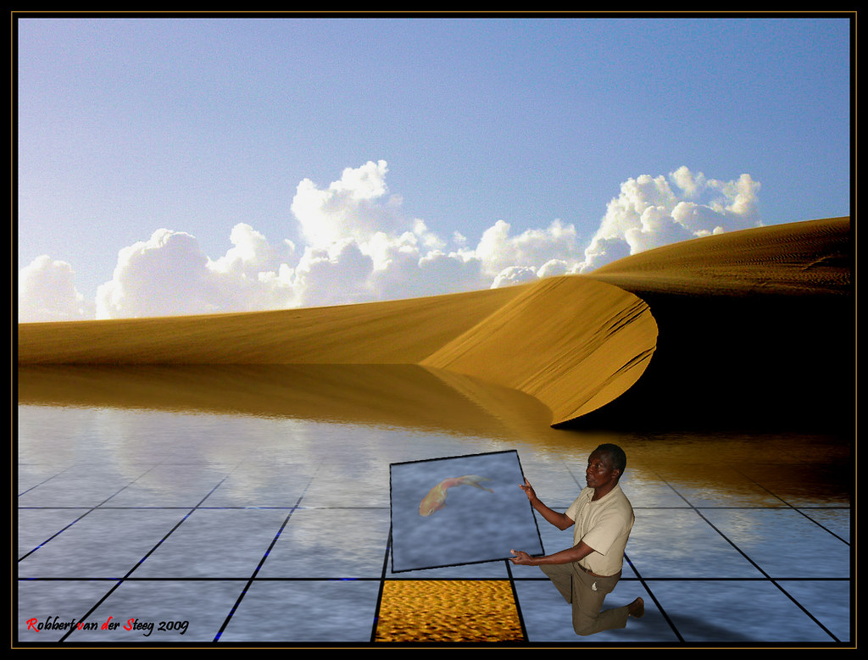
EFFECTS OF DESERTIFICATION

Slide 22
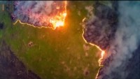

Slide 23
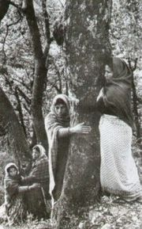
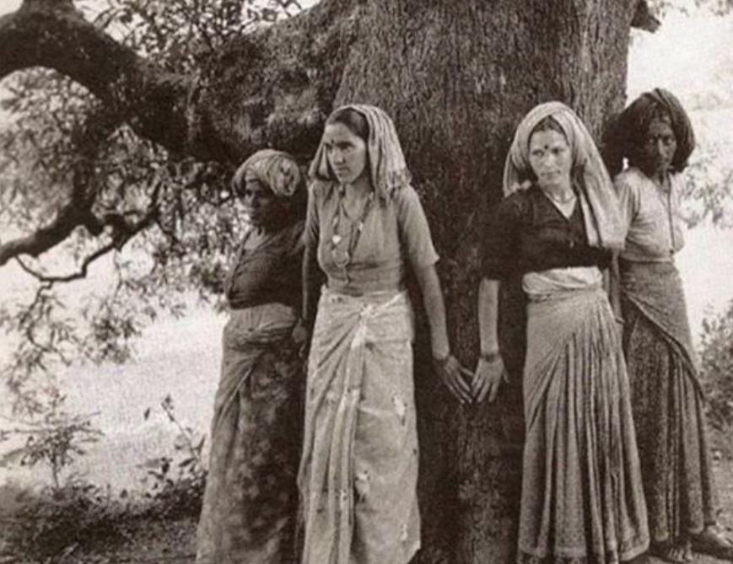
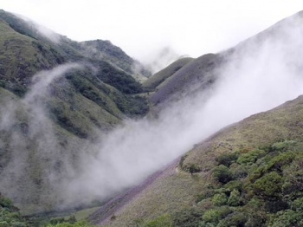
MOVEMENTS RAISED AGAINST DEFORESTATION AND DESERTIFICATION
THE BISHNOI MOVEMENT -(1700) AMRITHA DEVI
THE CHIPKO AND APPIKO MOVEMENTS –(1973) SUNDARLAL BAHUGUNA
SAVE SILENT VALLEY MOVEMENT –(1978) SUGHATHAKUMARI

Slide 24
FACTS OF DEFORESTATION AND DESERTIFICATION
SAALUMARADA THIMMAKKA ,an environmentalist from the state of Karnataka ,and Moirangetham Loiya from Manipur have contributed to control deforestation in our country.
CARGILL ,BLACKROCK ,WILMER INTERNATIONAL LIMITED ,WALMART ,JBS ,IKEA ,KORINDO GROUP PT ,YAKULT HONSHA CO.LTD ,STARBUCKS ,McDonald’s ,YUM! BRANDS ,PROCTER &GAMBLE(P&G) ,AHOLD DELHAIZE are the major companies responsible for Deforestation.

Slide 25
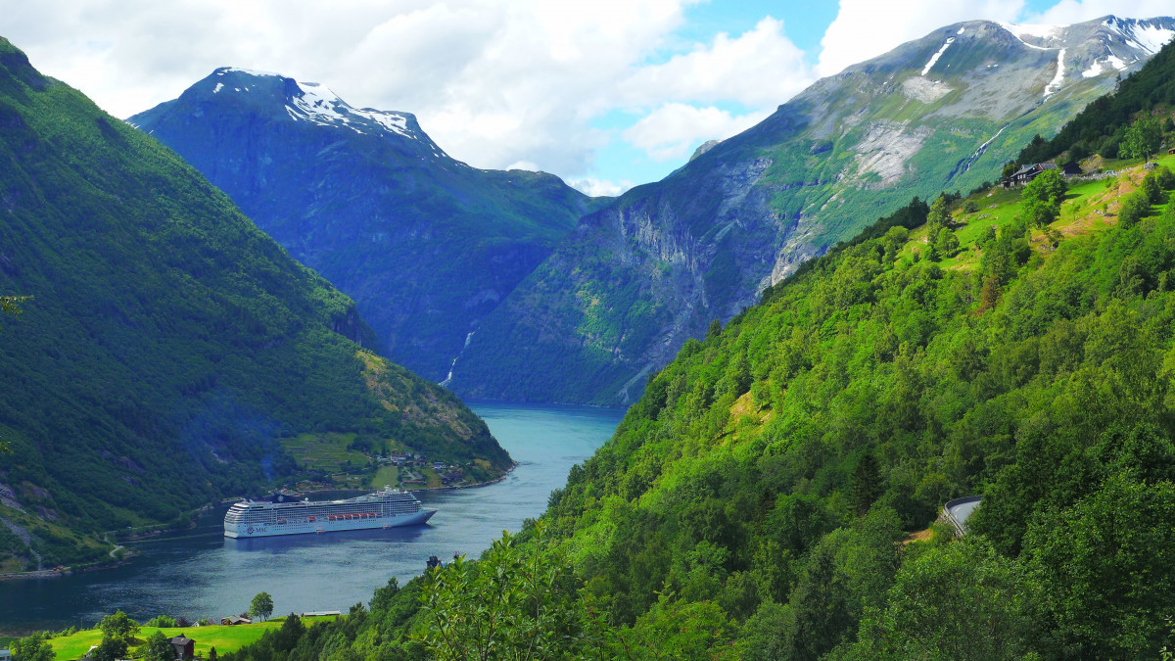

NORWAY IS THE FIRST COUNTRY TO BAN DEFORESTATION

Slide 26
PREVENTIVE MEASURES AGAINST DEFORESTATION AND DESERTIFICATION
Plant a tree ,Use less paper ,Recycle paper and cardboard ,Use recycled products ,Buy only Sustainable wood products ,Don’t buy products containing palm oil ,Do not burn fire wood Excessively.
Get educated ,spread the Word ,Join the Movement ,proper Utilization of forest resources ,Choose products that give back.

Slide 27
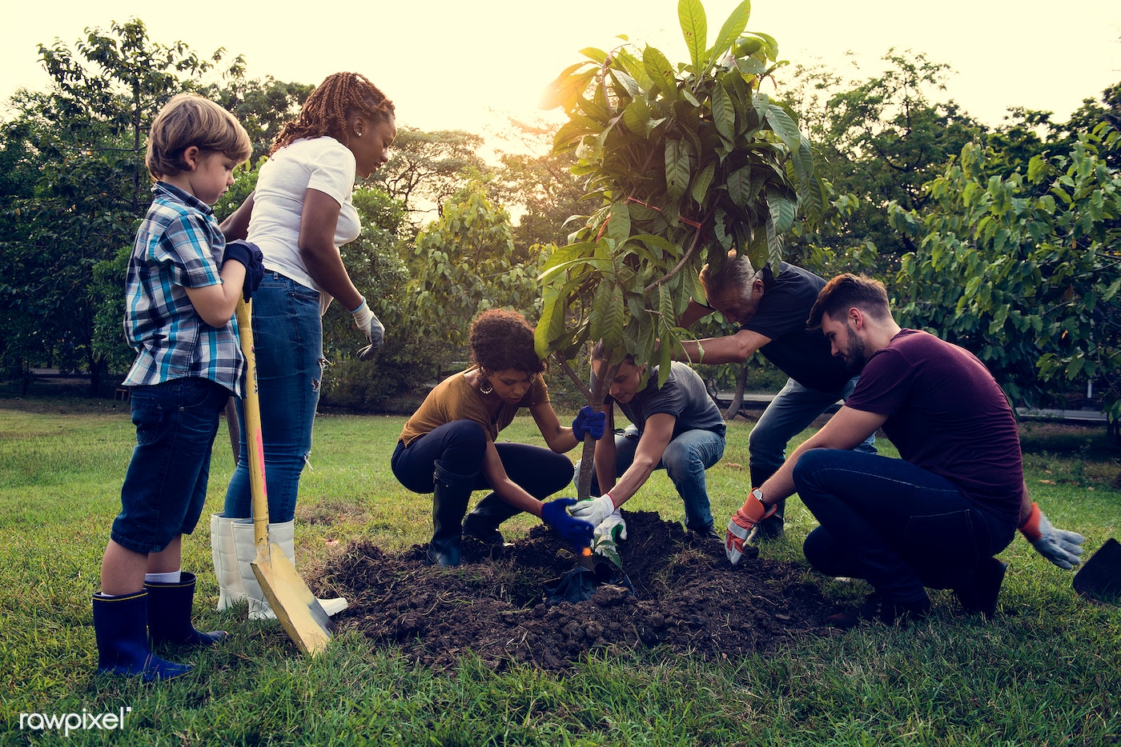
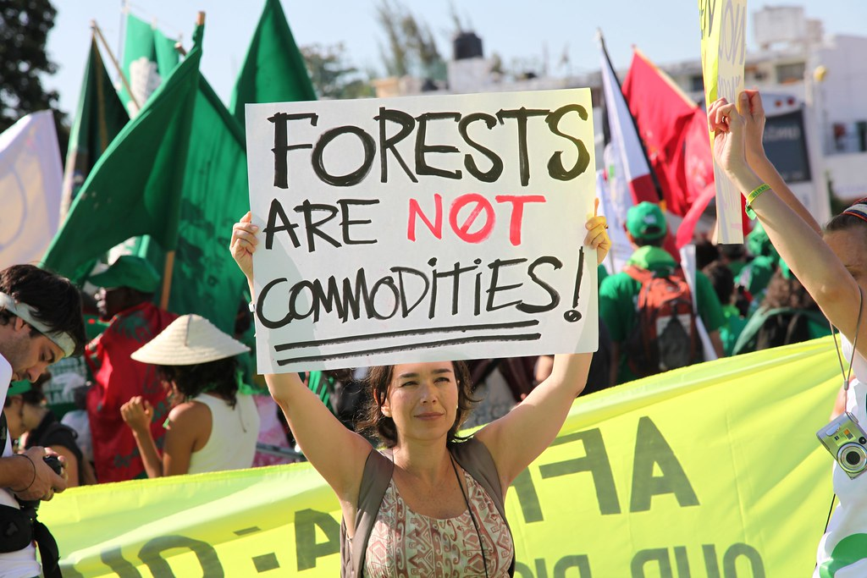

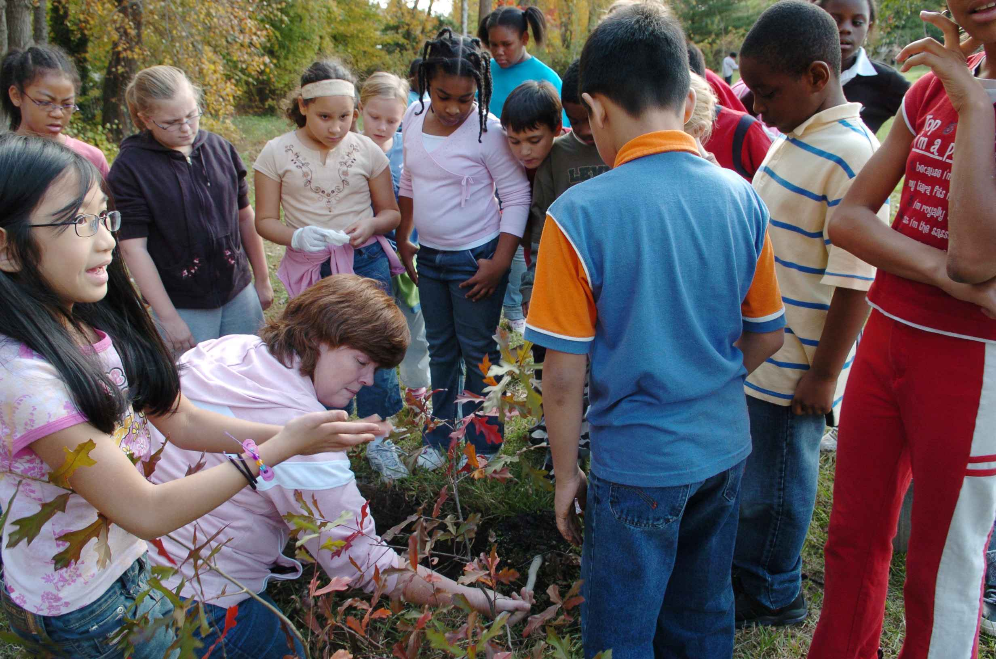
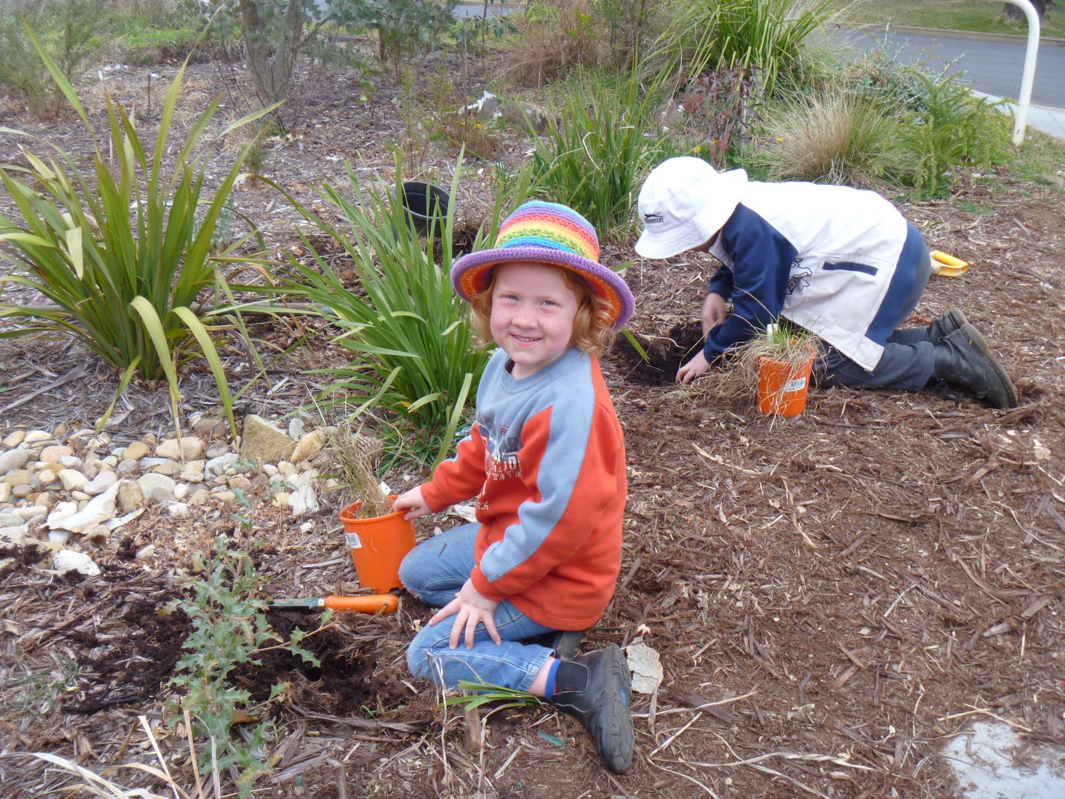
This Photo by Unknown Author is licensed under CC BY-NC-ND
This Photo by Unknown Author is licensed under CC BY-NC-ND

Slide 28

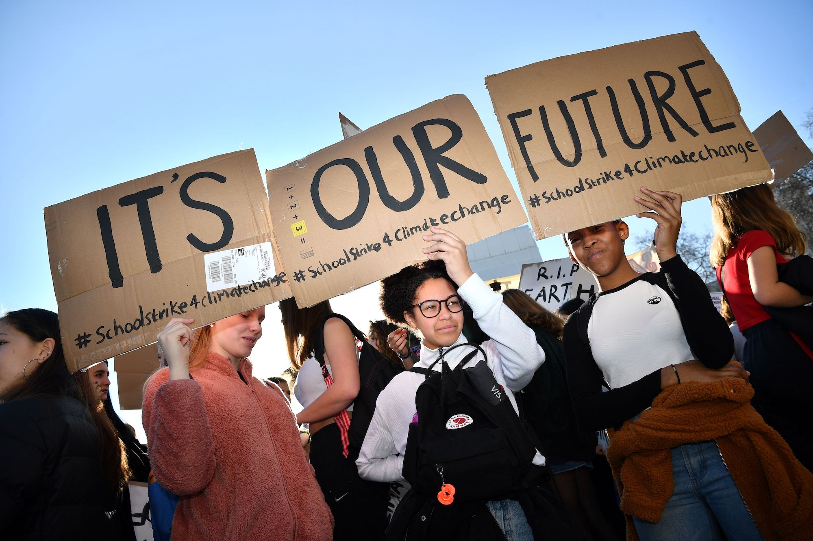
This Photo by Unknown Author is licensed under CC BY-NC-ND

Slide 29




EVERYTHING IS IN YOUR HANDS. CHANGE YOUR MIND ,TUNE YOUR BRAIN….
THANK YOU
This Photo by Unknown Author is licensed under CC BY-SA-NC

